Slide 1
AI Project
Application of Simulated Annealing To Optimization Problems
Name – Hrishikesh Athalye
MIS – 111803154
Class – TY Comp Div 2

Slide 2
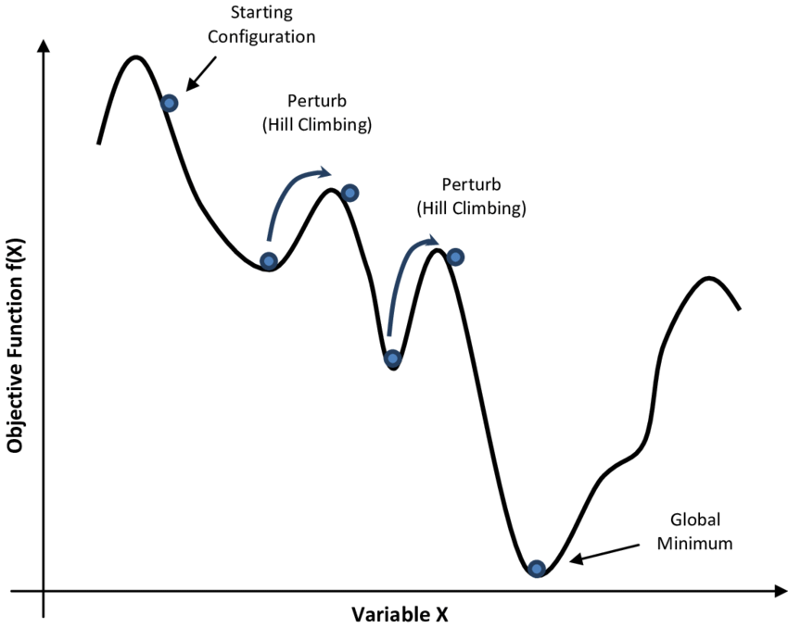
Simulated annealing - overview
Simulated Annealing is an algorithm in the category of metaheuristic algorithms – algorithms that help to choose a particular heuristic.
Metaheuristic algorithms are often inspired from natural phenomenon and they often yield approximately optimal results and an be used to reduce running time on NP Hard problems.
Simulated Annealing is inspired from the metallurgical principle of annealing – Controlled cooling of a heated material to produce desired physical characteristics.
In implementation, it is a mixture of exploration and exploitation strategies and helps avoid local optima, something that simple hill climbing fails to achieve. It does so by also accepting bad moves with some probability that changes with temperature.

Slide 3
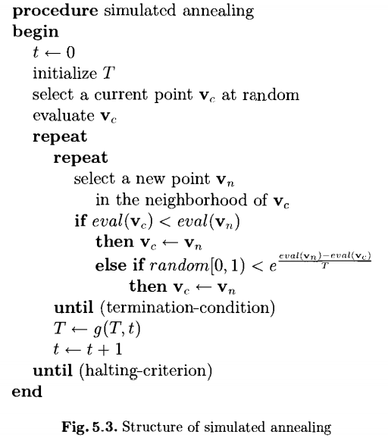
Implementation
All the three problems taken by me use the pseudocode on the right.
The commonly implemented version of the algorithm includes two loops:
A. An outer loop that checks if the temperature has fallen below a desired value
B. An inner loop that decides number of iterations in each temperature.
The temperature is decreased using a cooling schedule which controls how fast the temperature drops.
The number of iterations per temperature is also a function of temperature depending on if more iterations are needed at lower or higher temperatures.
The algorithm is a modification to stochastic hill climbing. The agent generates a random neighbour and if its cost is less it is accepted immediately. If its cost is higher then also it can be accepted, but with some probability – decided by computing the sigmoid function on the difference in costs.
At high temp, this probability is also high which means that the algorithm focuses on exploration initially , makes more mistakes and at lower temperatures, near stopping it does not reward bad moves and only focuses on exploitation of the metric.
This strategy makes it better than hill climbing and stops it from getting stuck in local optima.
- Taken from How to Solve It: Modern Heuristics – By Michalewicz

Slide 4
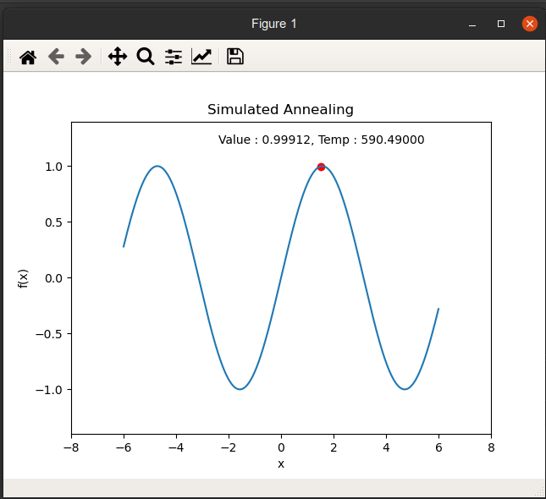
Problems solved and Agents
Optima Finding Agent – An agent that finds the optima in a function.
Heuristic - SA + Greedy Heuristic.
Search Space – 1d Function Curve
Goal – Minimum/Maximum f(x)

Slide 5
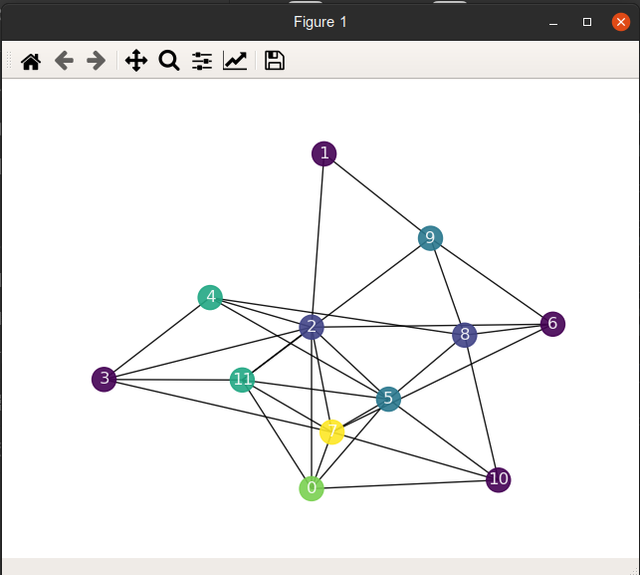
Problems solved and Agents
Map Coloring Problem – NP Hard
Heuristic – SA + Welsh Powell Heuristic
Search Space – Nodes of the graph
Goal – Colour all nodes of the map such that no two adjacent nodes have same colour, minimising number of colours

Slide 6
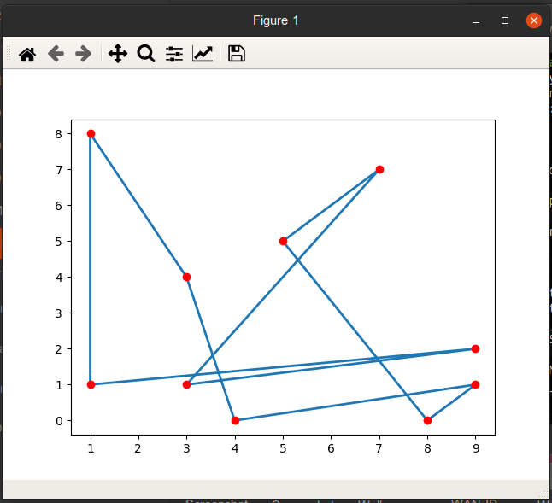
Problems solved and Agents – Contd.
Travelling Salesman Problem – NP hard
Agent – Travelling Salesman
Heuristic – SA + 2-Opt
Search Space – Graph of cities
Goal – Reach back to start node by visiting all nodes exactly once, minimising path cost.

Slide 7
Further Improvements
Choosing different cooling schedules – arithmetic, geometric, etc.
Choosing appropriate number of inner loop iterations.
Pairing with other local search strategies like random jumps, remembering history.
Combining with better heuristics.

